Slide 1
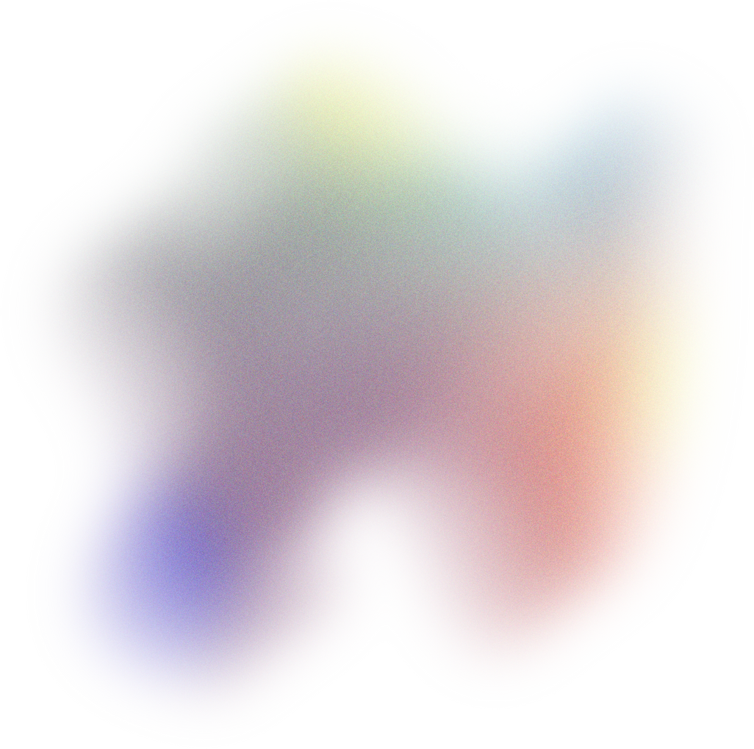


Introduction to Flutter
UNIVERSITY OF ST ANDREWS
MOBILE APPLICATION DEVELOPMENT
USING FLUTTER PLATFORM
CS3301 Group 5
Juan Ye
Rex
Hannah Telford
Lexie Svishchikova
Rishab

Slide 2
Key Features of Flutter
UNIVERSITY OF ST ANDREWS
Introduction to Flutter
MOBILE APPLICATION DEVELOPMENT
MOBILE APPLICATION DEVELOPMENT
Open-source UI software development framework
Created by Google in May 2017
Designed for building natively compiled applications for mobile, web, and desktop from a single codebase
Popular in the mobile app development world
USING FLUTTER PLATFORM
Fast
Productive
Multi-Platform
Compiles to ARM or Intel machine code and JavaScript
Build and iterate quickly with Hot Reload 🔥
Deploy to multiple devices from a single codebase
Flexible
Powered by Dart
Rich Set of Widgets
Create customized, adaptive designs that look and feel great on any screen
A language optimized for fast apps on any platform
That can be easily adapted to create complex user interfaces

Slide 3
Embedder
Dart
Rending
Native Plugins
App Packaging
Threads
Event Loops
Engine
C/C++
Service Protocol
Composition
Platform Channels
Dart Setup
Render
System Events
Runtime Mgmt
Frame Scheduling
Assets
Framework
Dart
Frame Pipeline
Text Layout
Material
Cupertino
Widgets
Rendering
Animation
Painting
Gestures
Component Technology
in Flutter
Foundation
Key Features of Flutter
Introduction to Flutter
Fast
Productive
Multi-Platform
Compiles to ARM or Intel machine code and JavaScript
Build and iterate quickly with Hot Reload 🔥
Deploy to multiple devices from a single codebase
Flexible
Powered by Dart
Rich Set of Widgets
Create customized, adaptive designs that look and feel great on any screen
A language optimized for fast apps on any platform
That can be easily adapted to create complex user interfaces

Slide 4
Key Features of Flutter
Flutter
Framework:
Component Technology
in Flutter
Framework
Dart
Material
Cupertino
Widgets
Rendering
- Component layer that developers interface with
- The Framework is the top layer written in Dart for a modern and reactive architecture
- Most of the Framework acts as an abstraction for the UI creation and interaction
- Most 3rd party dependencies/plugins interface with the Framework
Animation
Painting
Gestures
Foundation
Fast
Multi-Platform
Engine
C/C++
Service Protocol
Composition
Platform Channels
Compiles to ARM or Intel machine code and JavaScript
Deploy to multiple devices from a single codebase
Dart Setup
Render
System Events
Runtime Mgmt
Frame Scheduling
Assets
Flexible
Frame Pipeline
Text Layout
Rich Set of Widgets
Create customized, adaptive designs that look and feel great on any screen
Embedder
Dart
That can be easily adapted to create complex user interfaces
Rending
Native Plugins
App Packaging
Threads
Event Loops
Productive
Build and iterate quickly with Hot Reload 🔥
Powered by Dart
A language optimized for fast apps on any platform

Slide 5
Component Technology
in Flutter
Flutter
Framework:
Framework
Dart
Material
Cupertino
Widgets
- Component layer that developers interface with
- The Framework is the top layer written in Dart for a modern and reactive architecture
- Most of the Framework acts as an abstraction for the UI creation and interaction
- Most 3rd party dependencies/plugins interface with the Framework
Rendering
Animation
Painting
Gestures
Foundation
Engine
C/C++
Service Protocol
Composition
Platform Channels
Dart Setup
Render
System Events
Runtime Mgmt
Frame Scheduling
Assets
- Largest part and core of Flutter
- Low level implementation of Flutter’s API (Graphics, Network I/O, Plugin Architecture etc.)
- Low exposure to the framework makes abstraction easier and system stability high
Frame Pipeline
Text Layout
Embedder
Dart
Rending
Native Plugins
App Packaging
Threads
Event Loops

Slide 6
Framework
Dart
Material
Cupertino
Widgets
Rendering
Animation
Painting
Gestures
Foundation
Component Technology
in Flutter
Flutter
Engine:
Engine
C/C++
Service Protocol
Composition
Platform Channels
Dart Setup
Render
System Events
- Largest part and core of Flutter
- Low level implementation of Flutter’s API (Graphics, Network I/O, Plugin Architecture etc.)
- Low exposure to the framework makes abstraction easier and system stability high
- Component layer that developers interface with
- The Framework is the top layer written in Dart for a modern and reactive architecture
- Most of the Framework acts as an abstraction for the UI creation and interaction
- Most 3rd party dependencies/plugins interface with the Framework
Runtime Mgmt
Frame Scheduling
Assets
Frame Pipeline
Text Layout
- Smallest and lowest-level component
- Talks to OS to get input, rendering, multi-threading, etc.
- Exposes API’s of all supported platforms (Android, IOS, Web)
Embedder
Dart
Rending
Native Plugins
App Packaging
Threads
Event Loops

Slide 7


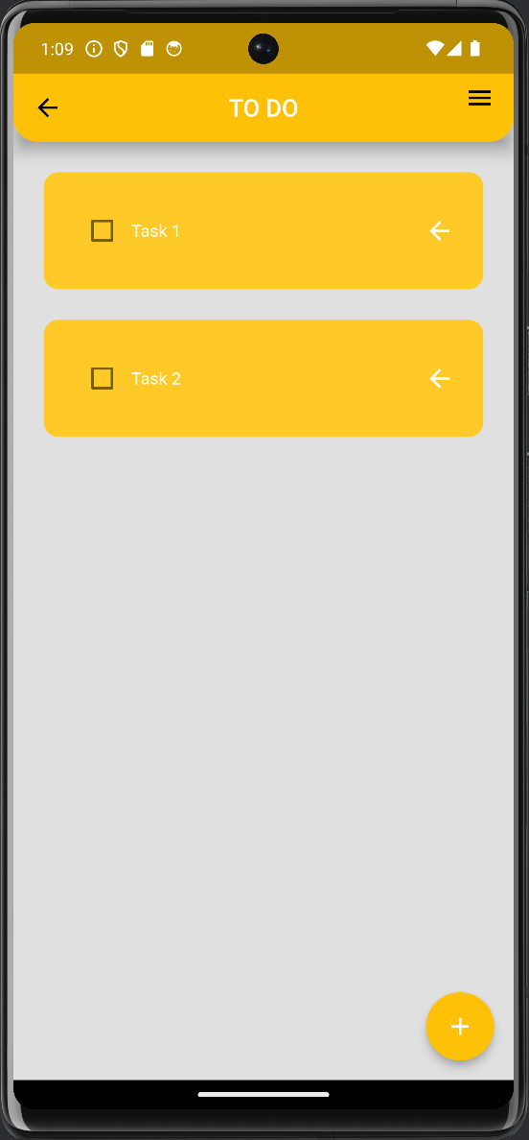
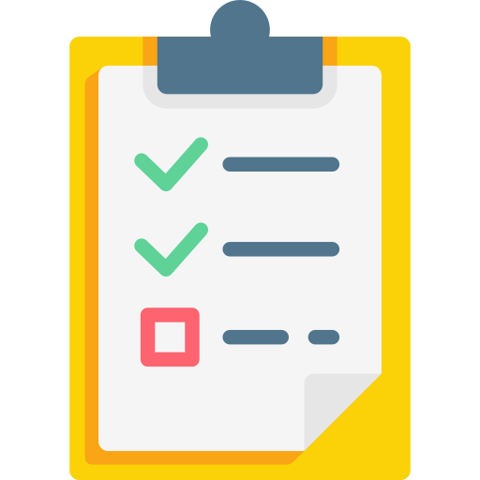

Widget Architecture In Practice
Engine
C/C++
Service Protocol
Composition
Platform Channels
Framework
Dart
Material
Cupertino
Dart Setup
Render
System Events
Widgets
Runtime Mgmt
Frame Scheduling
Assets
Rendering
Animation
Painting
Gestures
Frame Pipeline
Text Layout
Foundation
Component Technology
in Flutter
Embedder
Dart
Flutter
Embedder:
Widget build(BuildContext context) {
return Scaffold(
backgroundColor: Colors.grey[300],
appBar: AppBar(
leading: BackButton(
onPressed: () {
Navigator.of(context).pop(); },),
title: Text(
'TO DO',
textAlign: TextAlign.center,
style: TextStyle(fontSize: 20.0, color: Colors.white), ),
actions: [
Builder(builder: (context) {
return IconButton(
alignment: Alignment.topLeft,
onPressed: () {
Scaffold.of(context).openEndDrawer();},
icon: const Icon(Icons.menu_outlined));})
],
floatingActionButton: FloatingActionButton(
onPressed: createNewTask,
child: Icon(Icons.add, color: Colors.white),),
body: ListView.builder(
itemCount: db.todoList.length,
itemBuilder: (context, index) {
return ToDoTile(
taskName: db.todoList[index][0],
taskCompleted: db.todoList[index][1],
onChanged: (value) => checkBoxChanged(value, index),
deleteFunction: (context) => deleteTask(index),
);
}, ),); }
Rending
Native Plugins
App Packaging
Threads
Event Loops
- Smallest and lowest-level component
- Talks to OS to get input, rendering, multi-threading, etc.
- Exposes API’s of all supported platforms (Android, IOS, Web)
- Largest part and core of Flutter
- Low level implementation of Flutter’s API (Graphics, Network I/O, Plugin Architecture etc.)
- Low exposure to the framework makes abstraction easier and system stability high
- Component layer that developers interface with
- The Framework is the top layer written in Dart for a modern and reactive architecture
- Most of the Framework acts as an abstraction for the UI creation and interaction
- Most 3rd party dependencies/plugins interface with the Framework
Mobile App Demonstration
Dashboard Page
access to various features and functionalities

Slide 8
Embedder
Dart
Rending
Native Plugins
App Packaging
Threads
Event Loops
Widget Architecture In Practice
Widget build(BuildContext context) {
return Scaffold(
backgroundColor: Colors.grey[300],
appBar: AppBar(
leading: BackButton(
onPressed: () {
Navigator.of(context).pop(); },),
title: Text(
'TO DO',
textAlign: TextAlign.center,
style: TextStyle(fontSize: 20.0, color: Colors.white), ),
actions: [
Builder(builder: (context) {
return IconButton(
alignment: Alignment.topLeft,
onPressed: () {
Scaffold.of(context).openEndDrawer();},
icon: const Icon(Icons.menu_outlined));})
],
floatingActionButton: FloatingActionButton(
onPressed: createNewTask,
child: Icon(Icons.add, color: Colors.white),),
body: ListView.builder(
itemCount: db.todoList.length,
itemBuilder: (context, index) {
return ToDoTile(
taskName: db.todoList[index][0],
taskCompleted: db.todoList[index][1],
onChanged: (value) => checkBoxChanged(value, index),
deleteFunction: (context) => deleteTask(index),
);
}, ),); }
Mobile App Demonstration
Dashboard Page
access to various features and functionalities

Slide 9
Embedder
Dart
Rending
Native Plugins
App Packaging
Threads
Event Loops
Widget Architecture In Practice
Widget build(BuildContext context) {
return Scaffold(
backgroundColor: Colors.grey[300],
appBar: AppBar(
leading: BackButton(
onPressed: () {
Navigator.of(context).pop(); },),
title: Text(
'TO DO',
textAlign: TextAlign.center,
style: TextStyle(fontSize: 20.0, color: Colors.white), ),
actions: [
Builder(builder: (context) {
return IconButton(
alignment: Alignment.topLeft,
onPressed: () {
Scaffold.of(context).openEndDrawer();},
icon: const Icon(Icons.menu_outlined));})
],
floatingActionButton: FloatingActionButton(
onPressed: createNewTask,
child: Icon(Icons.add, color: Colors.white),),
body: ListView.builder(
itemCount: db.todoList.length,
itemBuilder: (context, index) {
return ToDoTile(
taskName: db.todoList[index][0],
taskCompleted: db.todoList[index][1],
onChanged: (value) => checkBoxChanged(value, index),
deleteFunction: (context) => deleteTask(index),
);
}, ),); }
Mobile App Demonstration
Dashboard Page
access to various features and functionalities

Slide 10
Embedder
Dart
Rending
Native Plugins
App Packaging
Threads
Event Loops
Widget Architecture In Practice
Widget build(BuildContext context) {
return Scaffold(
backgroundColor: Colors.grey[300],
appBar: AppBar(
leading: BackButton(
onPressed: () {
Navigator.of(context).pop(); },),
title: Text(
'TO DO',
textAlign: TextAlign.center,
style: TextStyle(fontSize: 20.0, color: Colors.white), ),
actions: [
Builder(builder: (context) {
return IconButton(
alignment: Alignment.topLeft,
onPressed: () {
Scaffold.of(context).openEndDrawer();},
icon: const Icon(Icons.menu_outlined));})
],
floatingActionButton: FloatingActionButton(
onPressed: createNewTask,
child: Icon(Icons.add, color: Colors.white),),
body: ListView.builder(
itemCount: db.todoList.length,
itemBuilder: (context, index) {
return ToDoTile(
taskName: db.todoList[index][0],
taskCompleted: db.todoList[index][1],
onChanged: (value) => checkBoxChanged(value, index),
deleteFunction: (context) => deleteTask(index),
);
}, ),); }
Mobile App Demonstration
Dashboard Page
access to various features and functionalities

Slide 11
Embedder
Dart
Rending
Native Plugins
App Packaging
Threads
Event Loops
Widget Architecture In Practice
Widget build(BuildContext context) {
return Scaffold(
backgroundColor: Colors.grey[300],
appBar: AppBar(
leading: BackButton(
onPressed: () {
Navigator.of(context).pop(); },),
title: Text(
'TO DO',
textAlign: TextAlign.center,
style: TextStyle(fontSize: 20.0, color: Colors.white), ),
actions: [
Builder(builder: (context) {
return IconButton(
alignment: Alignment.topLeft,
onPressed: () {
Scaffold.of(context).openEndDrawer();},
icon: const Icon(Icons.menu_outlined));})
],
floatingActionButton: FloatingActionButton(
onPressed: createNewTask,
child: Icon(Icons.add, color: Colors.white),),
body: ListView.builder(
itemCount: db.todoList.length,
itemBuilder: (context, index) {
return ToDoTile(
taskName: db.todoList[index][0],
taskCompleted: db.todoList[index][1],
onChanged: (value) => checkBoxChanged(value, index),
deleteFunction: (context) => deleteTask(index),
);
}, ),); }
Mobile App Demonstration
Dashboard Page
access to various features and functionalities

Slide 12
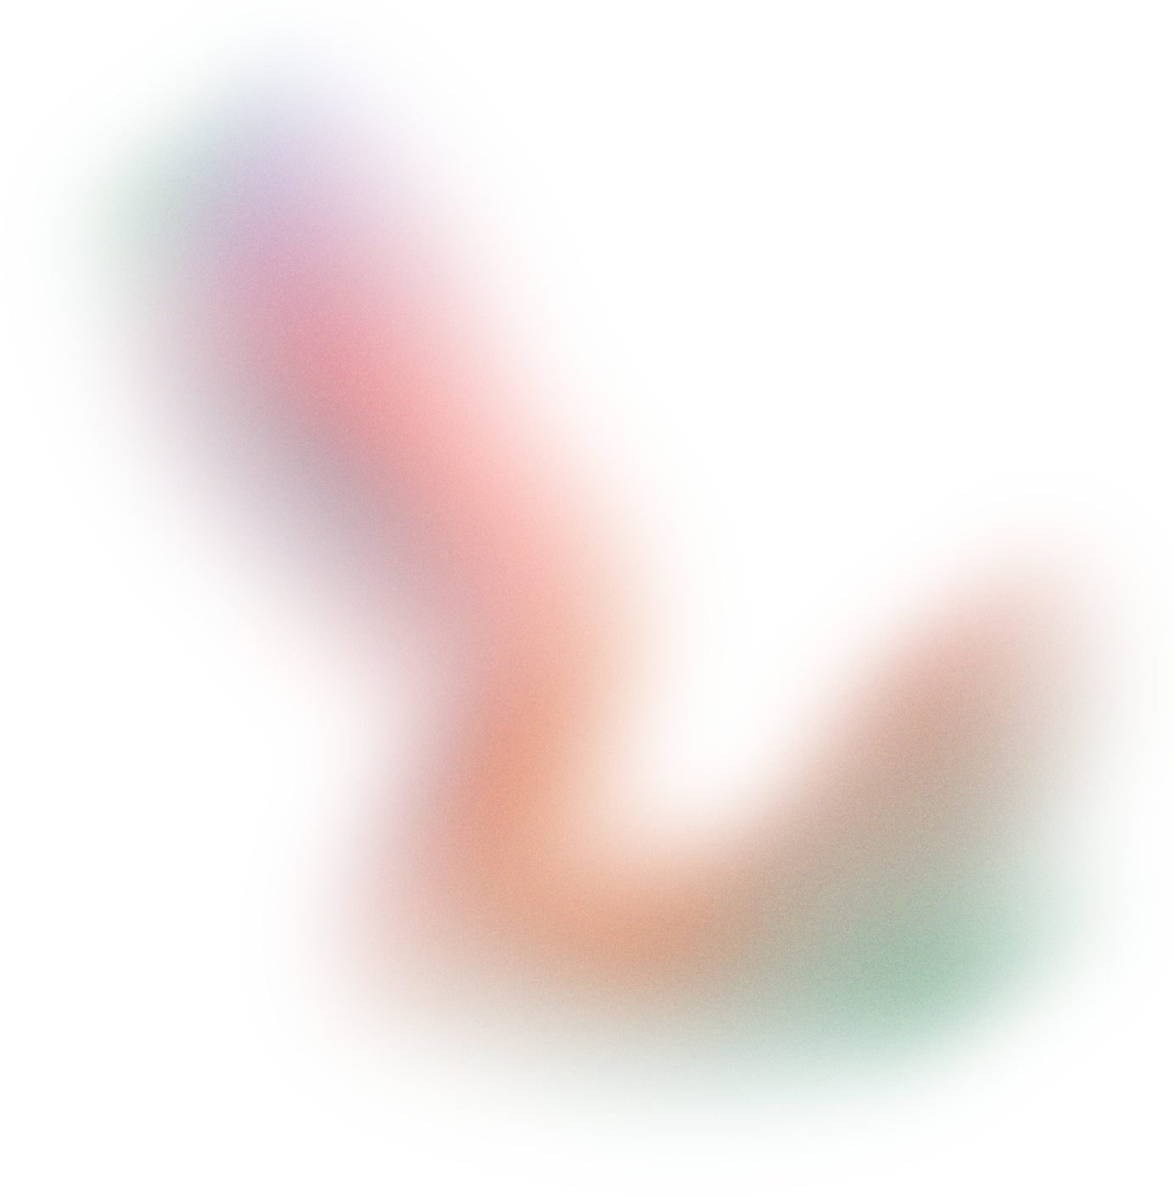


Widget Architecture In Practice
Widget build(BuildContext context) {
return Scaffold(
backgroundColor: Colors.grey[300],
appBar: AppBar(
leading: BackButton(
onPressed: () {
Navigator.of(context).pop(); },),
title: Text(
'TO DO',
textAlign: TextAlign.center,
style: TextStyle(fontSize: 20.0, color: Colors.white), ),
actions: [
Builder(builder: (context) {
return IconButton(
alignment: Alignment.topLeft,
onPressed: () {
Scaffold.of(context).openEndDrawer();},
icon: const Icon(Icons.menu_outlined));})
],
floatingActionButton: FloatingActionButton(
onPressed: createNewTask,
child: Icon(Icons.add, color: Colors.white),),
body: ListView.builder(
itemCount: db.todoList.length,
itemBuilder: (context, index) {
return ToDoTile(
taskName: db.todoList[index][0],
taskCompleted: db.todoList[index][1],
onChanged: (value) => checkBoxChanged(value, index),
deleteFunction: (context) => deleteTask(index),
);
}, ),); }
App Demonstration
My Notes
Central component
of our Flutter app
Resource Overview:
Notes Pad
Expenses Tracker
To-Do List
Mood Tracker
Mobile App Demonstration
Intuitive Navigation
Dashboard Page
Navigation Drawer
access to various features and functionalities
Consistent Design

Slide 13


App Demonstration
My Expenses Tracker
App Demonstration
My Notes
Access and manage your notes effortlessly
Create, edit, and organize your notes, helping you stay organized and productive
Here goes the screenshot

Slide 14
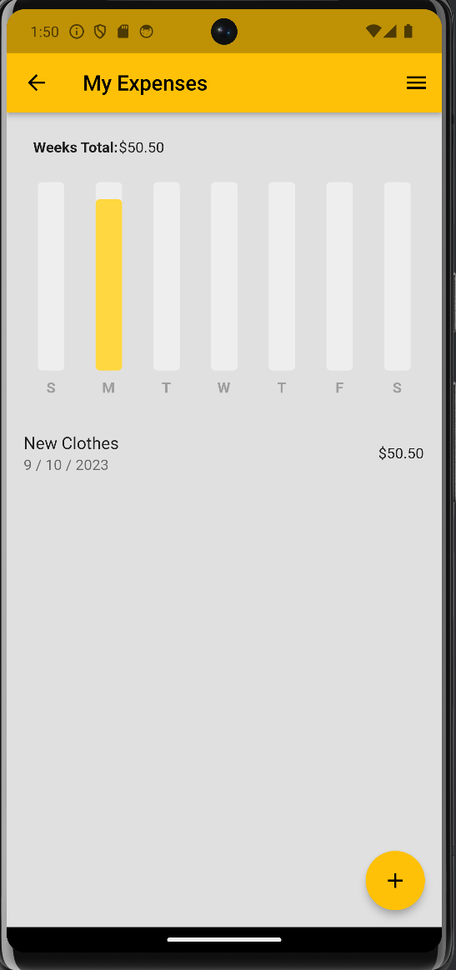
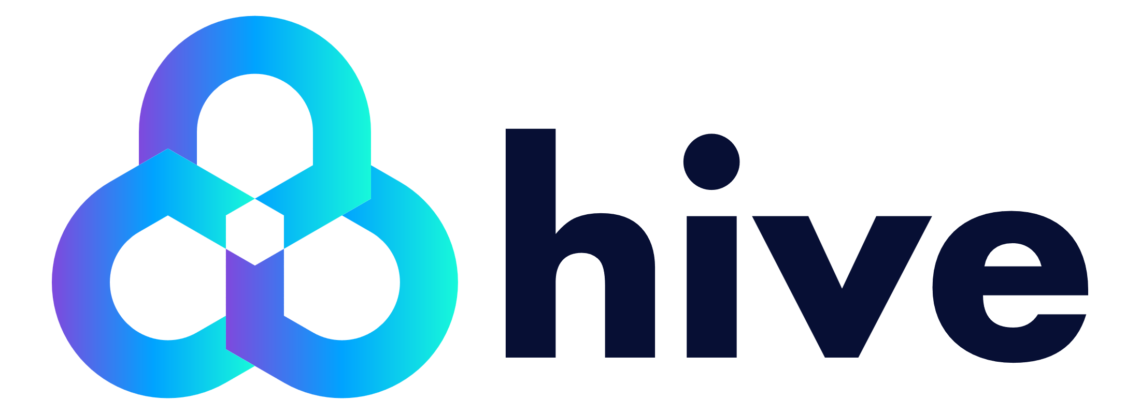
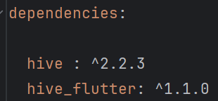
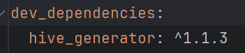
App Demonstration
My Notes
App Demonstration
My To-Do List
App Demonstration
My Expenses Tracker
Keep track of your expenses with the Expense Tracker
Easy to visualize expense summaries
Tracks weekly balances and cache’s expense data-base using Hive
Hive works as a simple service for saving data and data management
Pubspec.yaml

Slide 15
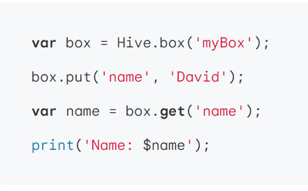
App Demonstration
My Notes
App Demonstration
My To-Do List
App Demonstration
My Expenses Tracker
Keep track of your expenses with the Expense Tracker
Easy to visualize expense summaries
Tracks weekly balances and cache’s expense data-base using Hive
Hive works as a simple service for saving data and data management
Import the dependency into flutter
Pubspec.yaml
MyBox
box.put
Expense Data

Slide 16
App Demonstration
My Notes
App Demonstration
My To-Do List
App Demonstration
My Expenses Tracker
Keep track of your expenses with the Expense Tracker
Easy to visualize expense summaries
Tracks weekly balances and cache’s expense data-base using Hive
Hive works as a simple service for saving data and data management
Create a Hive Box and Store Data in it
MyBox
box.put
Expense Data
Pubspec.yaml

Slide 17
App Demonstration
My Notes
App Demonstration
My To-Do List
App Demonstration
My Expenses Tracker
Keep track of your expenses with the Expense Tracker
Easy to visualize expense summaries
Tracks weekly balances and cache’s expense data-base using Hive
Hive works as a simple service for saving data and data management
Simply call get() on the data in the box to retrieve safely
Pubspec.yaml
MyBox
box.put
Expense Data

Slide 18
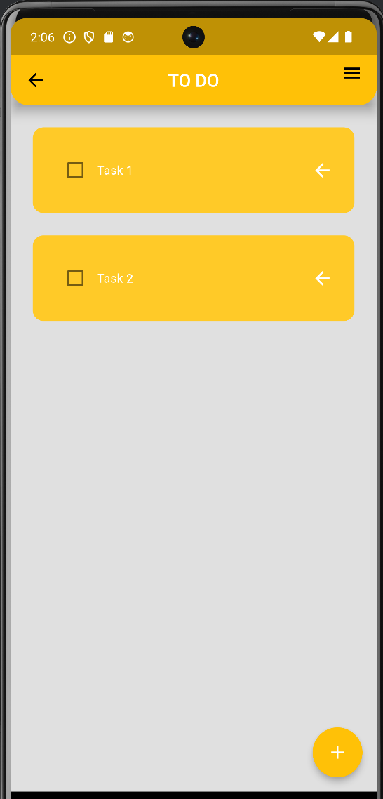
App Demonstration
My Expenses Tracker
App Demonstration
My Mood Tracker
App Demonstration
My To-Do List
Was the first feature implemented
Again, it uses hive to store persistent data like the task list
Tasks are reorderable and can be deleted by swiping
Simply call get() on the data in the box to retrieve safely

Slide 19
App Demonstration
My To-Do List
Insights and Downsides to Flutter
App Demonstration
My Mood Tracker
Monitor and analyze your mood over time with the Mood Tracker
Helps you gain insights into your emotional well-being and track mood trends
May be useful on your next session with phycologist

Slide 20

Mobile App Demonstration
My Mood Tracker
Q&A Session
Insights and Downsides to Flutter
Thank you for listening!

Slide 21
References
Q&A Session
Thank you for listening!

